Slide 1
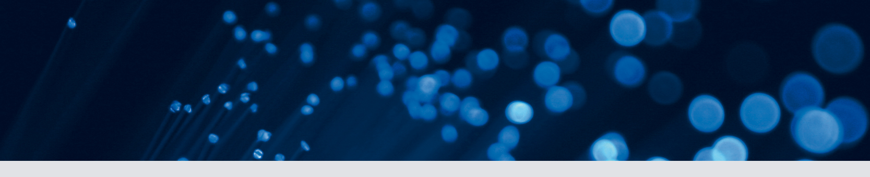
Deep Learning on the Analysis of Radiological Images
Konstantinos Kamnitsas
Biomedical Image Analysis group
Department of Computing Imperial College London
Presented as a tutorial in: Medical Image Understanding and Analysis 2017
konstantinos.kamnitsas12@imperial.ac.uk
https://github.com/Kamnitsask

Slide 2
Deep Learning
Automatically learn data-driven, hierarchical representations, to accomplish a task.
From Neocognitron [Fukushima 1980]:
Learns data-driven features itself: “If a set of stimulus patterns (input data) are repeatedly presented to it, it gradually acquires the ability to recognize these patterns.”
Do not engineer for one task, adapt by learning: “It is not necessary to give any instructions about the categories to which the stimulus patterns should belong.”

Slide 3
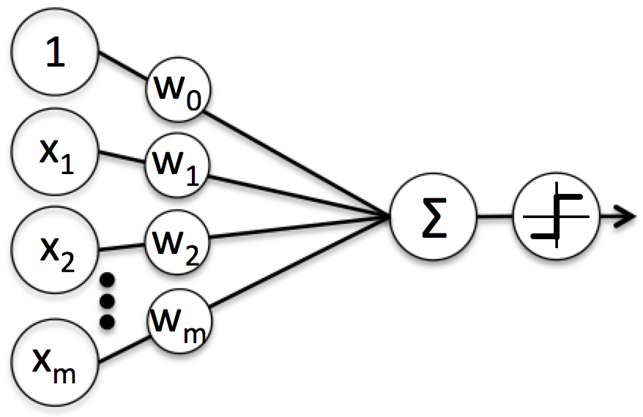
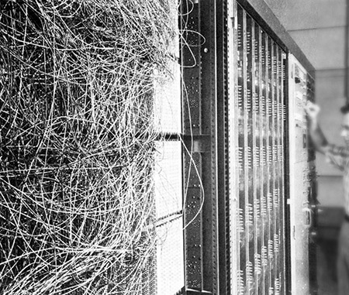
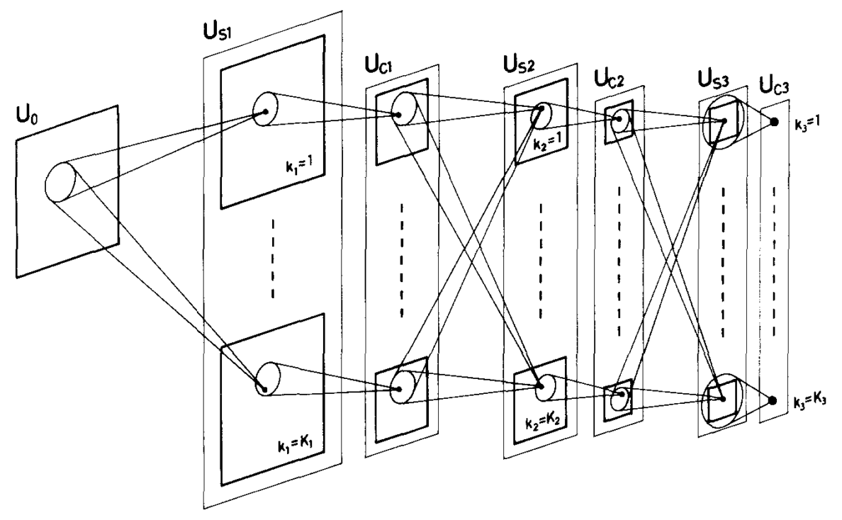
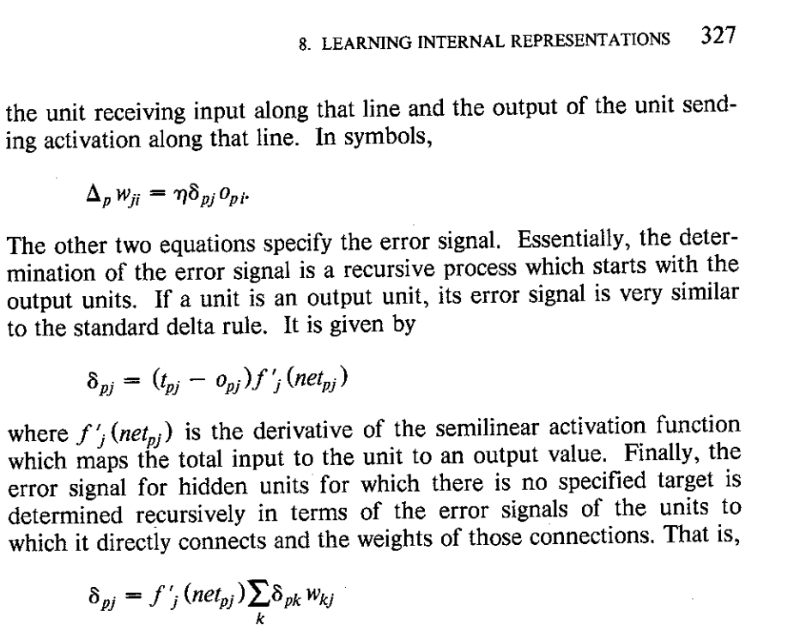
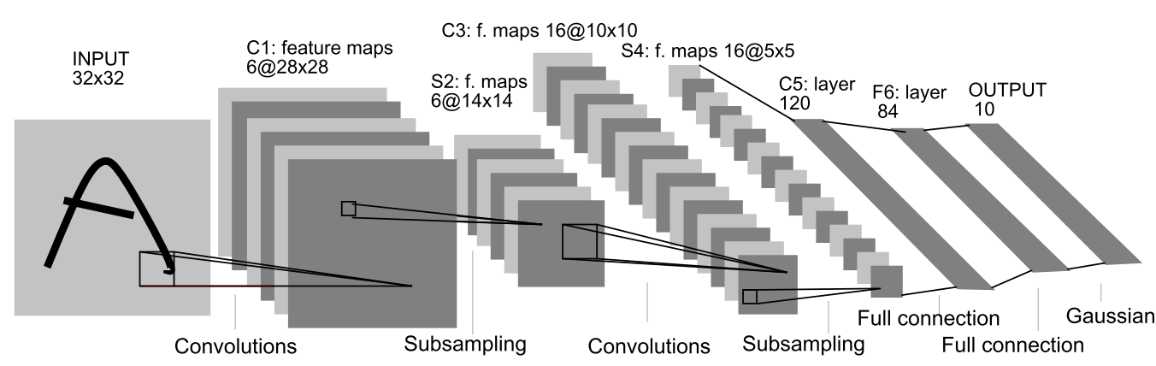
Some history on neural networks…
Perceptron [Rosenblatt 1958]:
Neocognitron [Fukushima 1980]:
Back-propagation [Rumelhart 1985]:
CNN [LeCunn1989]:

Slide 4

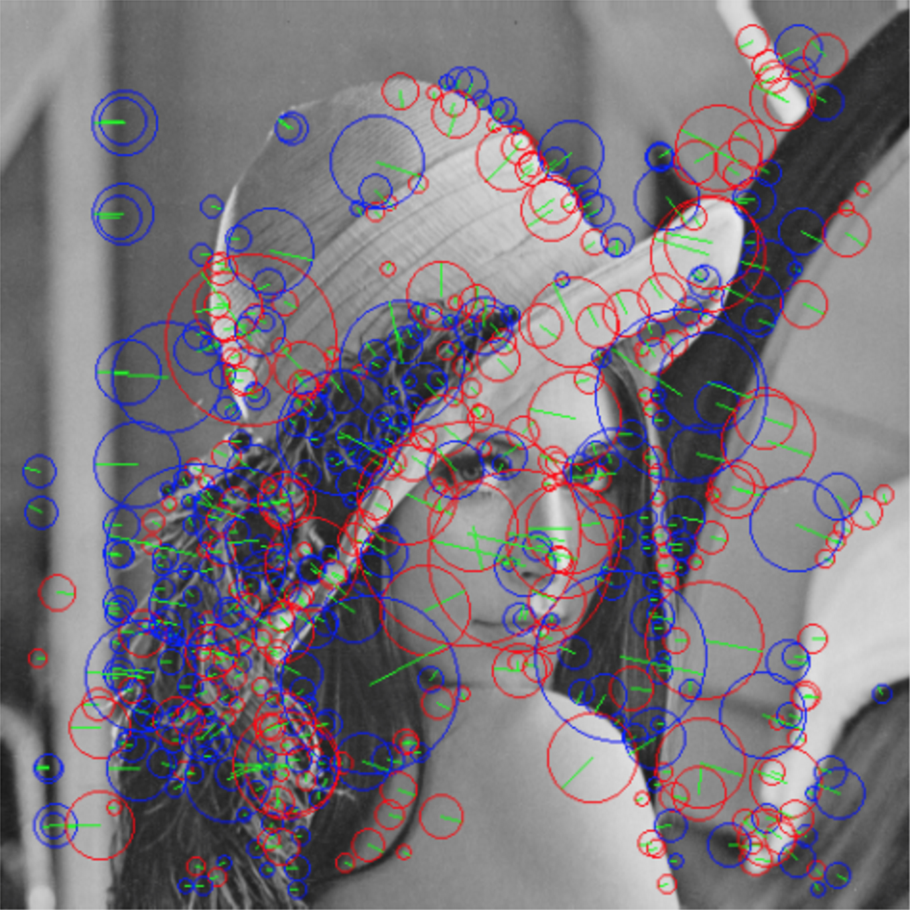
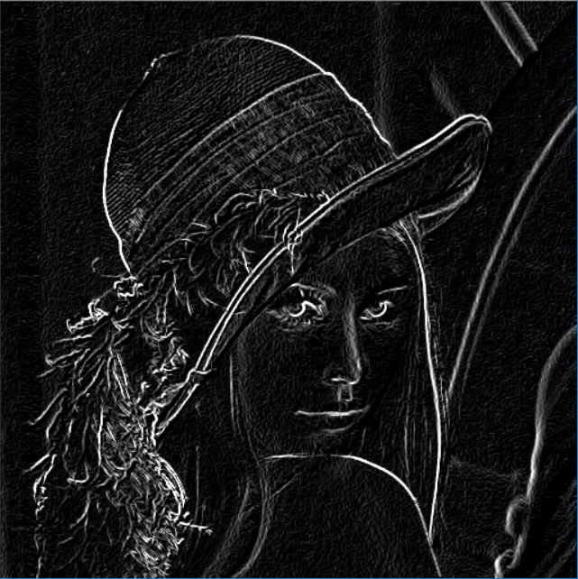
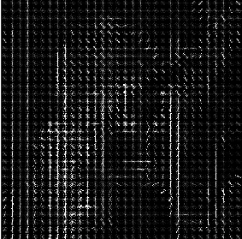
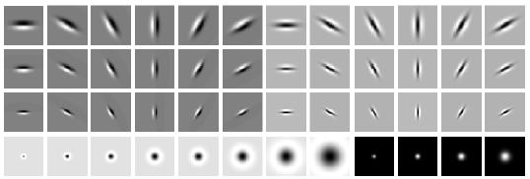
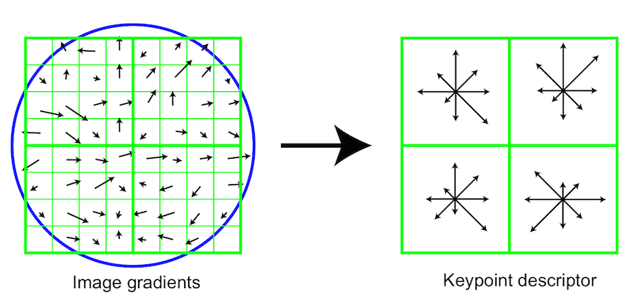
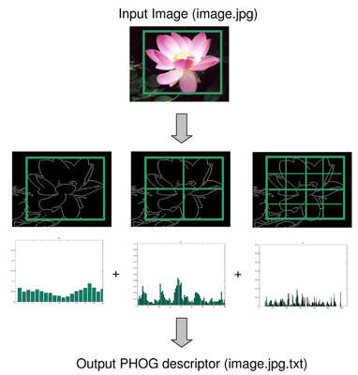
Traditional ML pipeline
Feature Representation
Classifier
Engineered Low Level Features
Texton
Sift
HoG
Notes:
Online convolution tool: https://gmicol.greyc.fr/

Slide 5
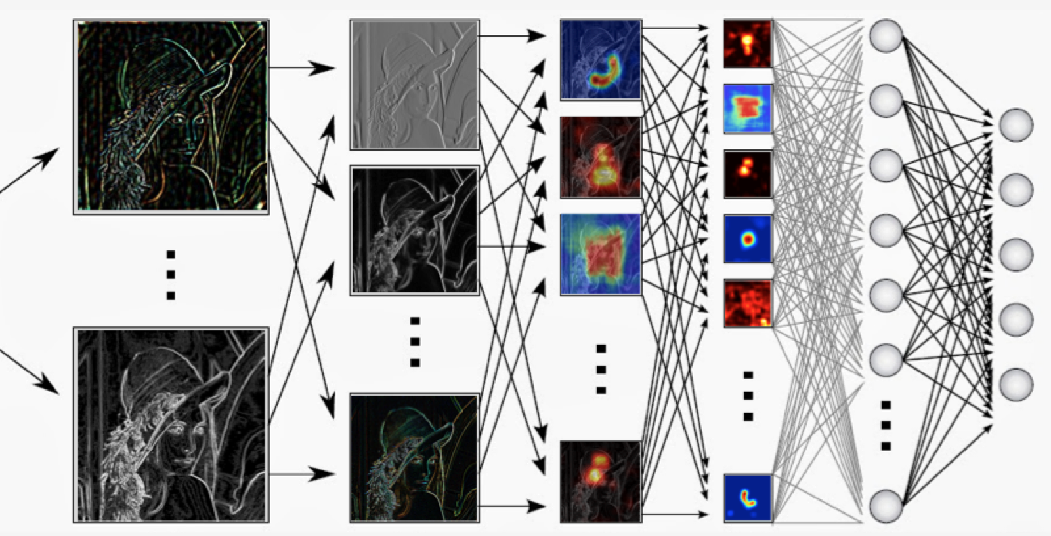
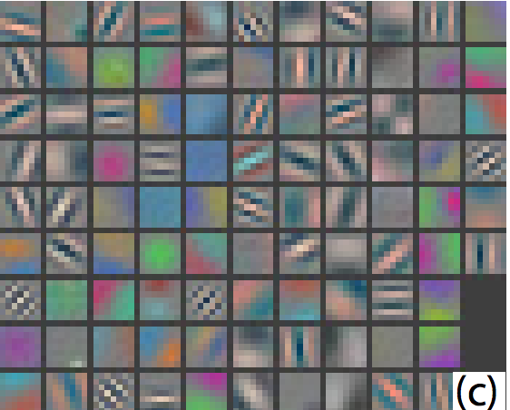
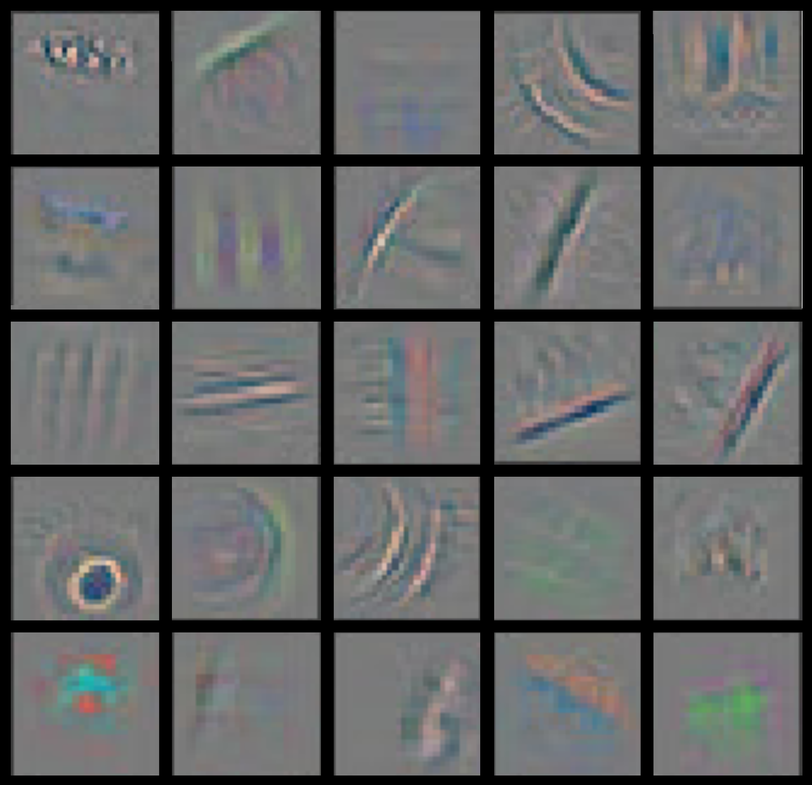
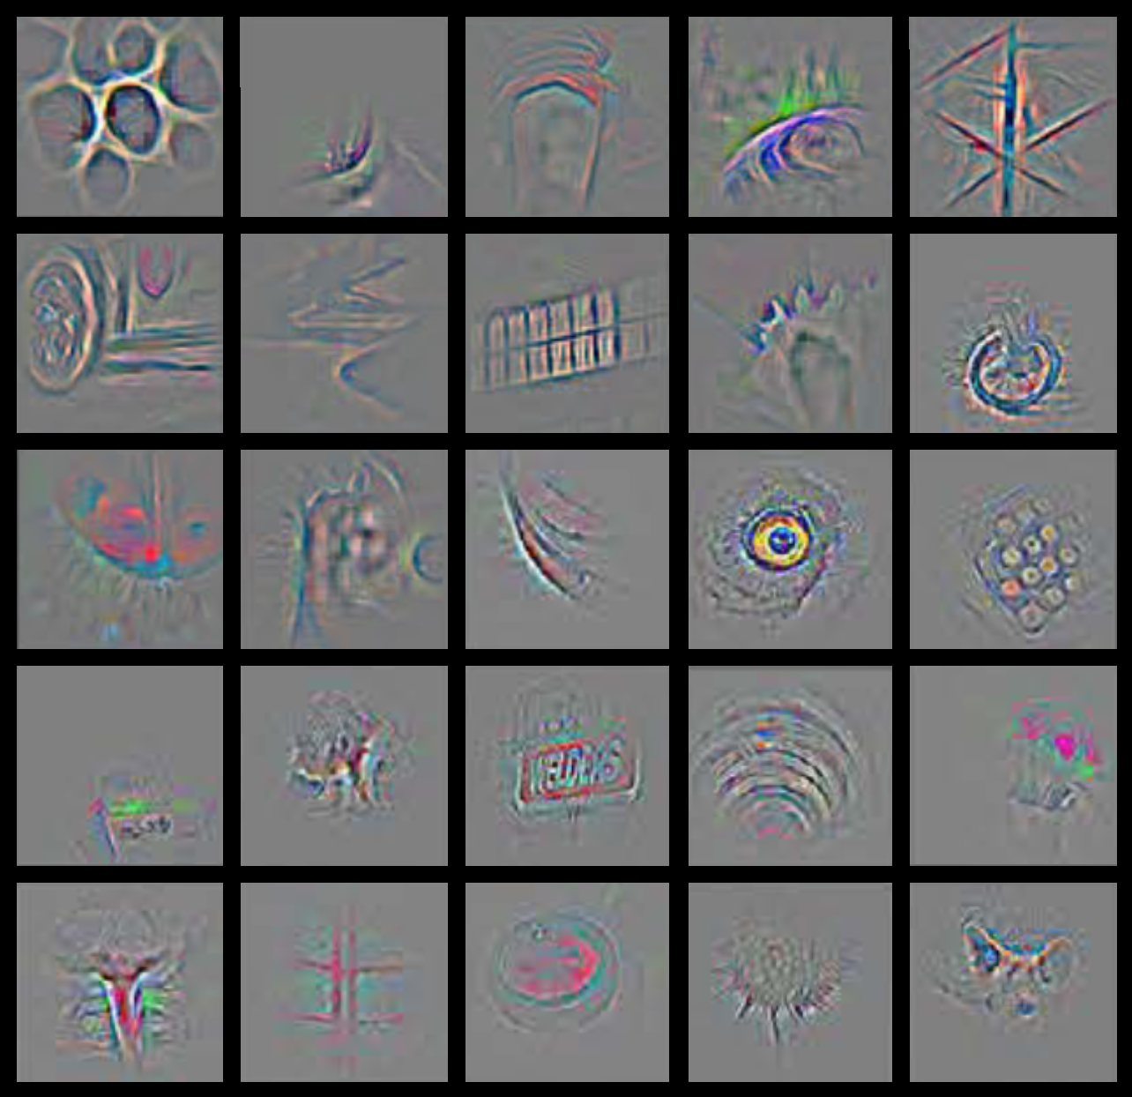
Deep Learning Pipeline
Classifier
Hierarchical Representation
Low-level
Mid-level
High-level

Slide 6
This talk is…
… not aiming to convince you of the power of Deep Learning.

Slide 7
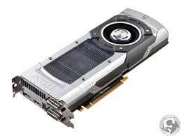
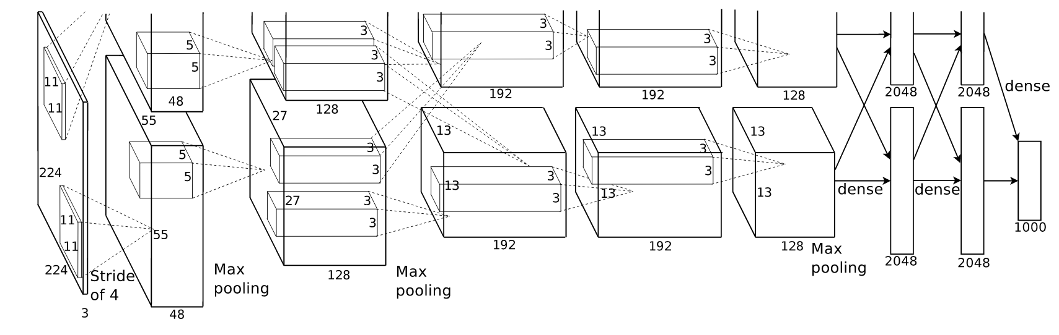
Revolution
LeNet [LeCunn1989]:
General Purpose GPU processing, eg CUDA 2007:
AlexNet [Krizhevski 2012]:

Slide 8
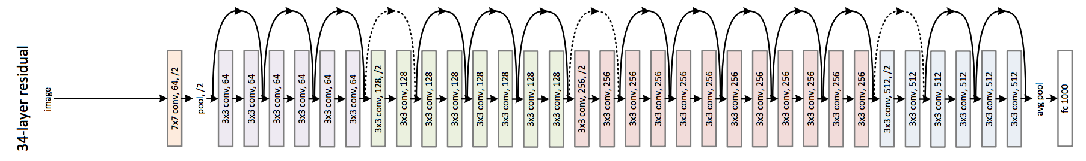

Evolution
AlexNet
GoogLeNet
ResNet

Slide 9
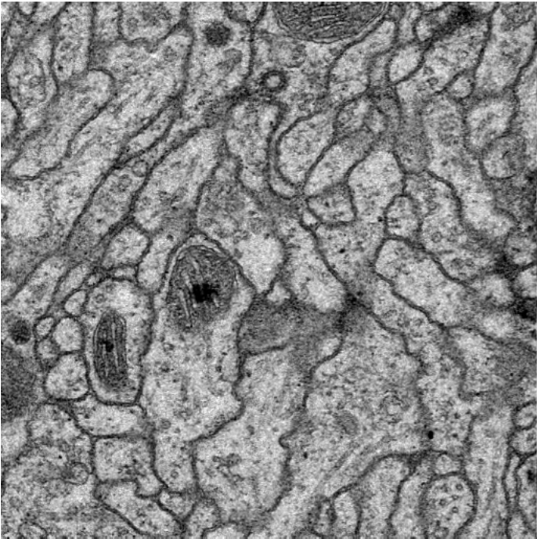
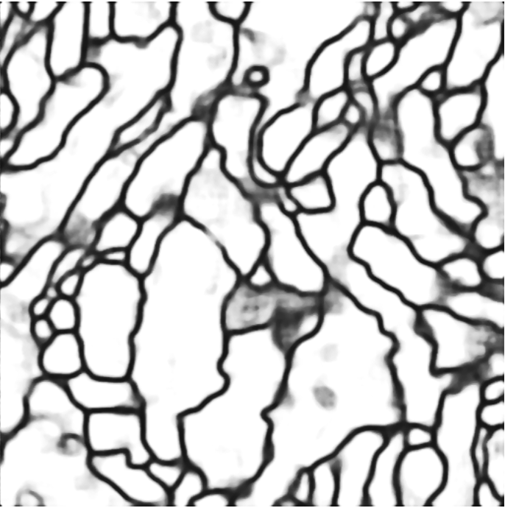
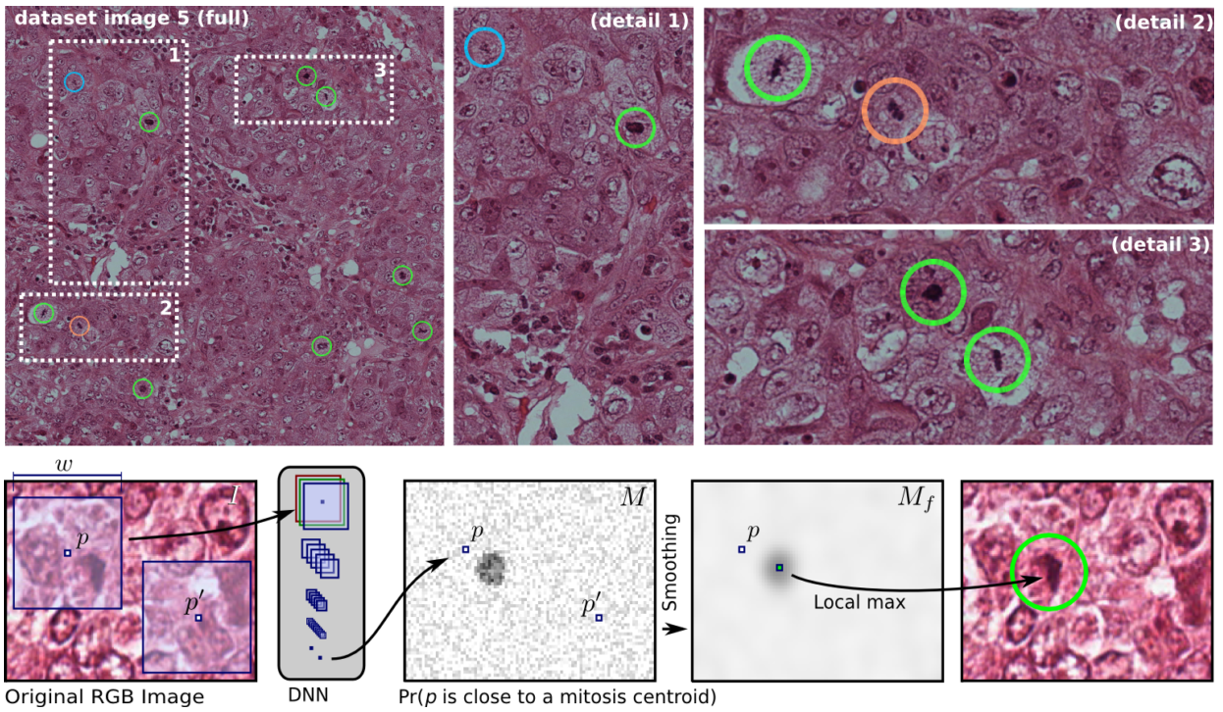
Medical imaging at the forefront of DL advances
ISBI’12 Challenge on Segmenting neuronal membranes [link]
Winner: Ciresan et al, Deep neural networks segment neuronal membranes in electron microscopy images, NIPS 2012.
ICPR’12 Contest on Mitosis Detection in Breast Histological Images [link]
Winner: Ciresan et al, Mitosis detection in breast cancer histology images with deep neural networks, MICCAI 2013.

Slide 10
This talk is…
… not a literature review.
For collections on biomedical papers:
Litjens et al, A survey on Deep Learning in Medical Image Analysis, arXiv 2017.
For Computer Vision / Machine Learning literature:
Terryum’s “Awesome deep Learning papers” github.
https://github.com/terryum/awesome-deep-learning-papers

Slide 11
This talk is…
Part 1
From perceptron to convolutional layers
Convolution arithmetic
Building a basic segmenter
Building a multi-pathway network
Results from DeepMedic
Part 2
Down-sampling via Pooling and Strided Convolution
Upsampling & Deconvolution
FCN
Unet
Important parts in SotA builds: Discussing Unet / DeepMedic
Class imbalance in FCNs
Deep Learning libraries
Look at code

Slide 12
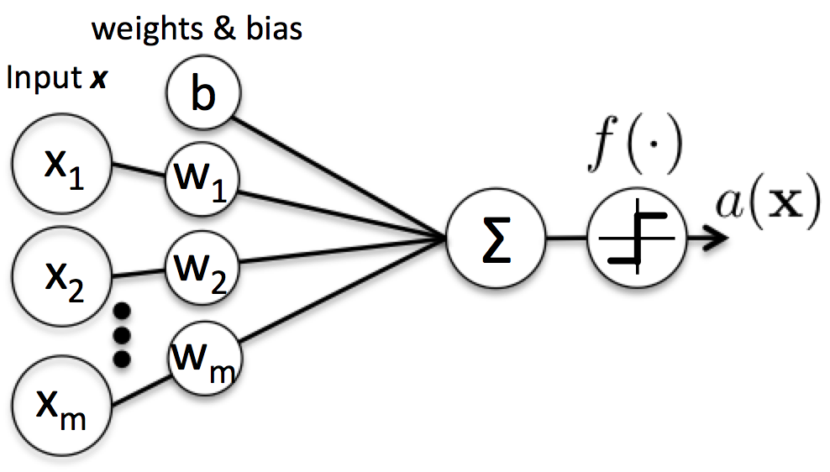
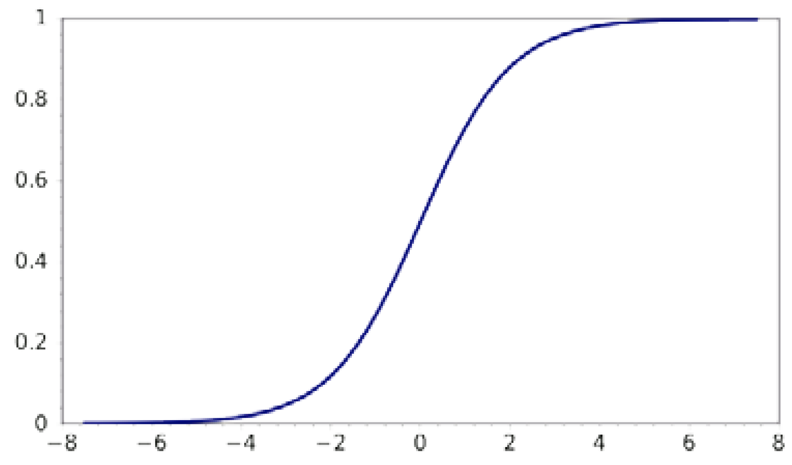
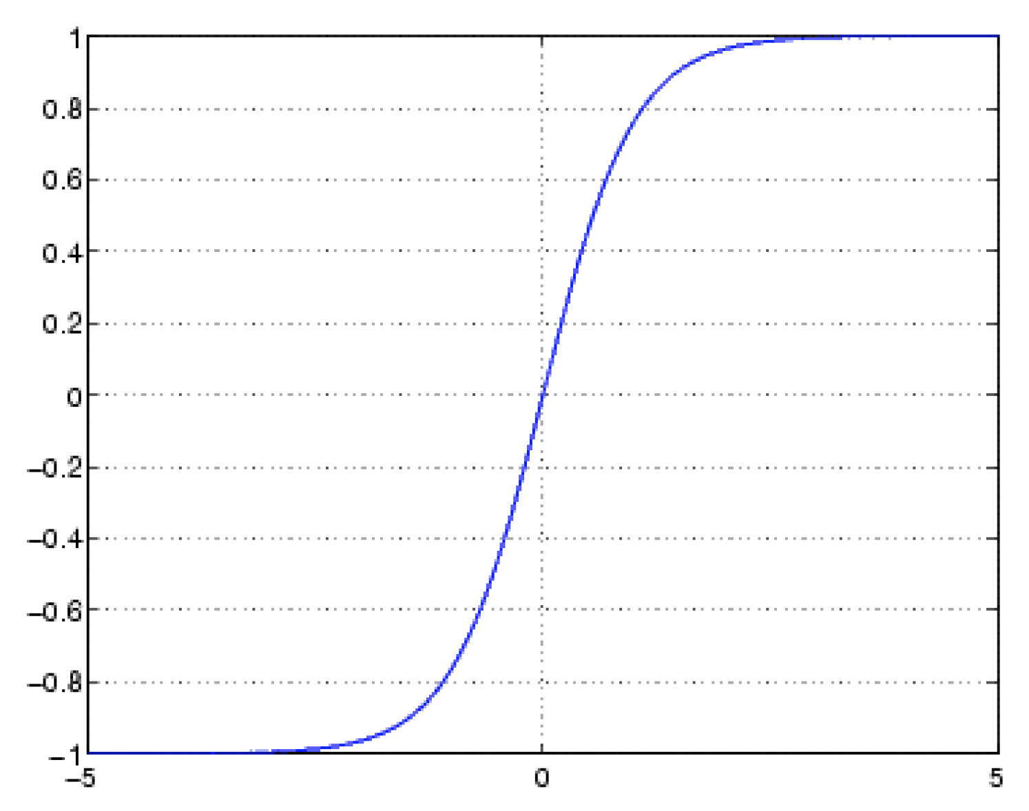
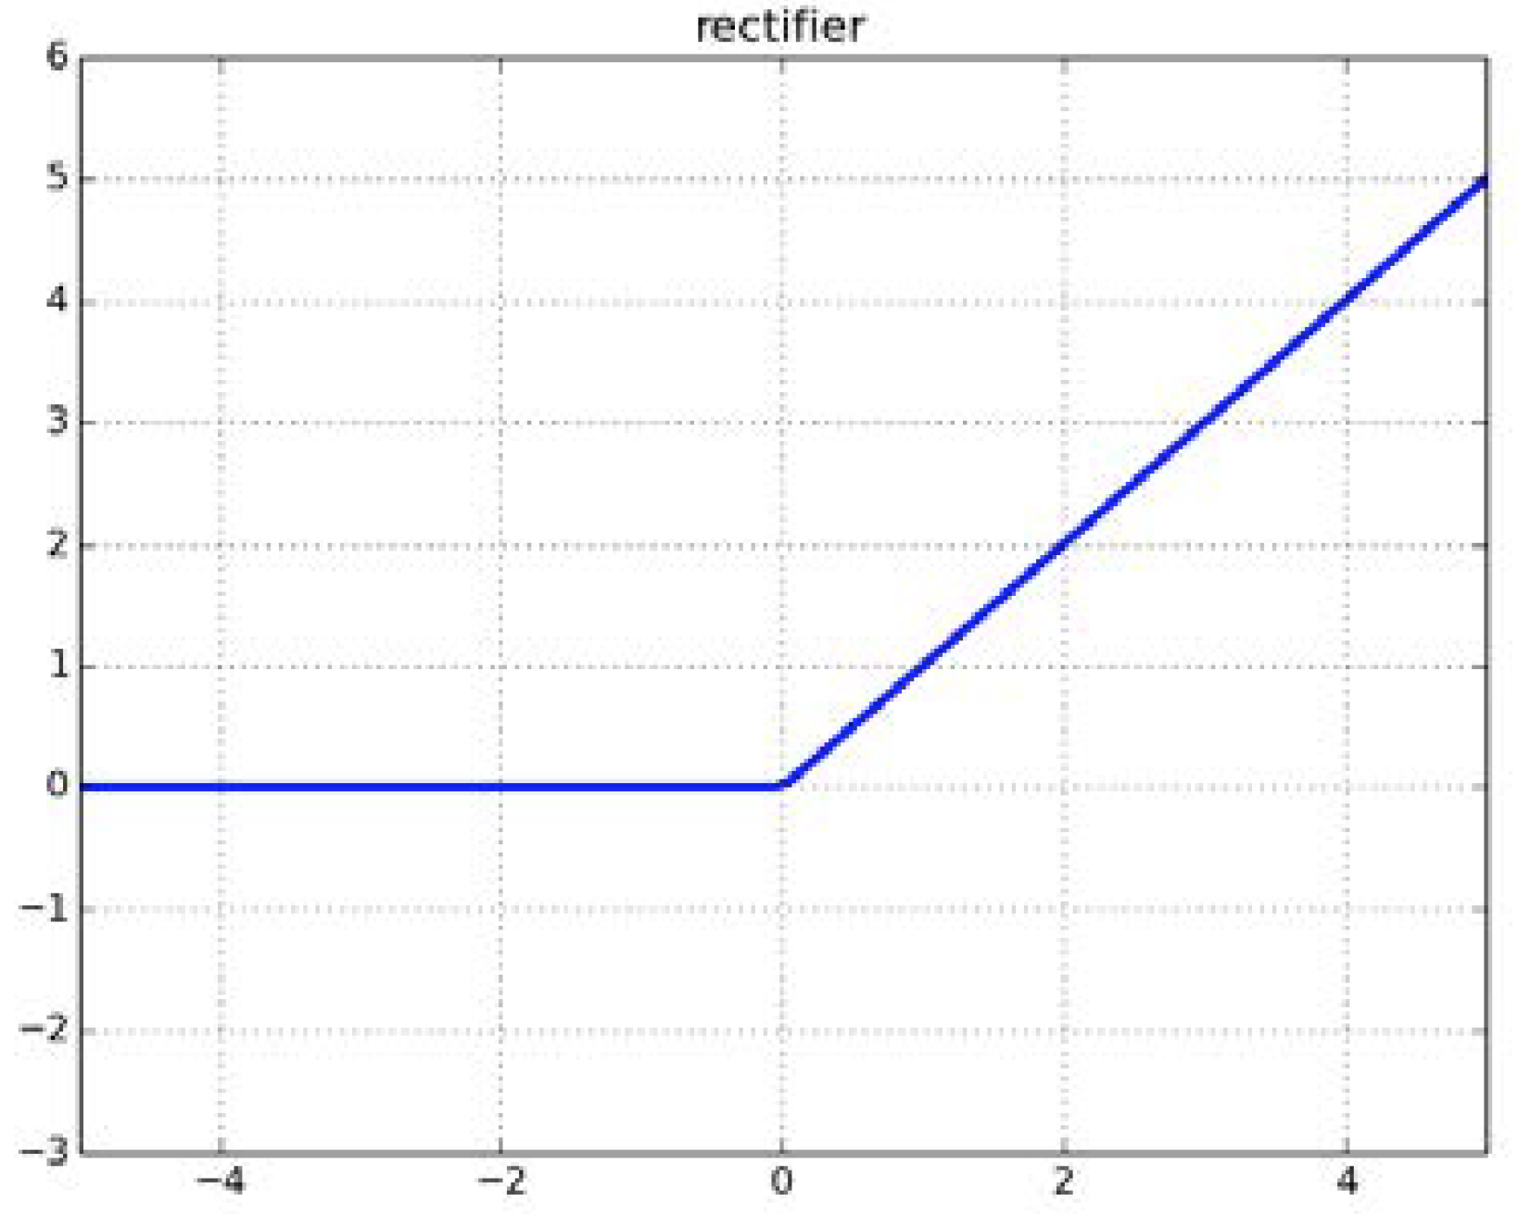
Perceptron
Neuron activation:
Loss:
Learning:
via gradient descent:
Activation functions:
Notes:
a( \mathbf{x}) = f \left( \sum_i w_i x_i + b \right)
\mathcal{L} = - \frac{1}{N} \sum_i^N (a(x_i) - y_i )^2
(\mathbf{w}, b) = \min_{(\mathbf{w},b)} \mathcal{L} (\mathbf{w}, b, \mathbf{X}, \mathbf{Y})
w_i^{(t+1)} = w_i^{(t)} + \frac{\partial \mathcal{L}} {\partial w_i^{(t)}}

Slide 13
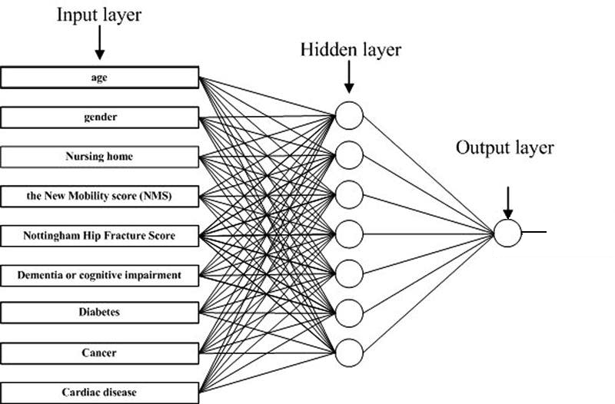
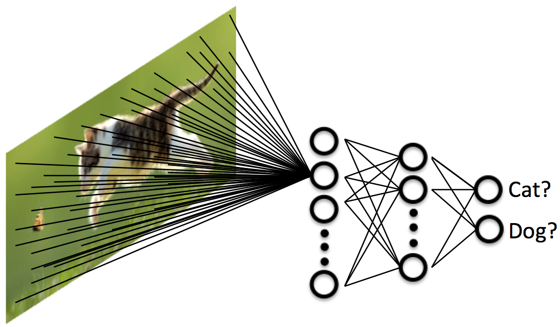
Multi Layer Perceptron
Notes:
Universal approximation theorem: 1 hidden layer and can learn everything.
So, you can apply it to learn to predict amazing things, like do outcome prediction of a patient. Or, discriminate images of cats and dogs. Of course most people worked on the cats and dogs.
But in none of the two problems does mlp work too well. Why?...

Slide 14
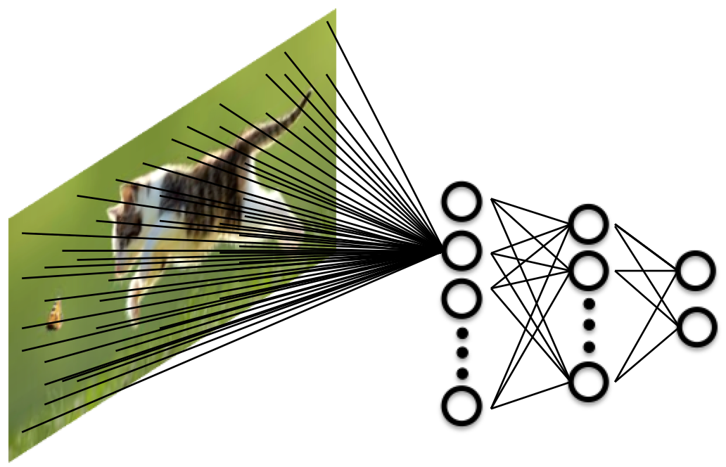
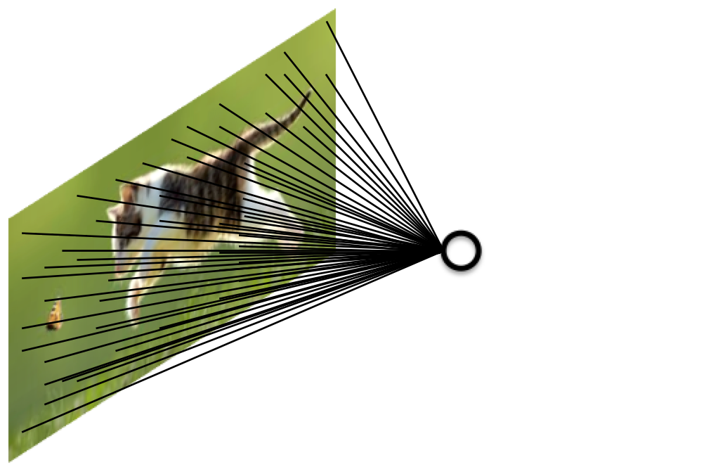
Fully Connected Neurons
Features are local.
Only nearby pixels correlate!
Each neuron detects one feature/pattern.
One pattern over the whole image.
Too many weights for each neuron/pattern.
Example:
100x100 image = 10000 weights/pattern.
Notes:
… because an mlp has fully connected neurons. Each neuron…

Slide 15
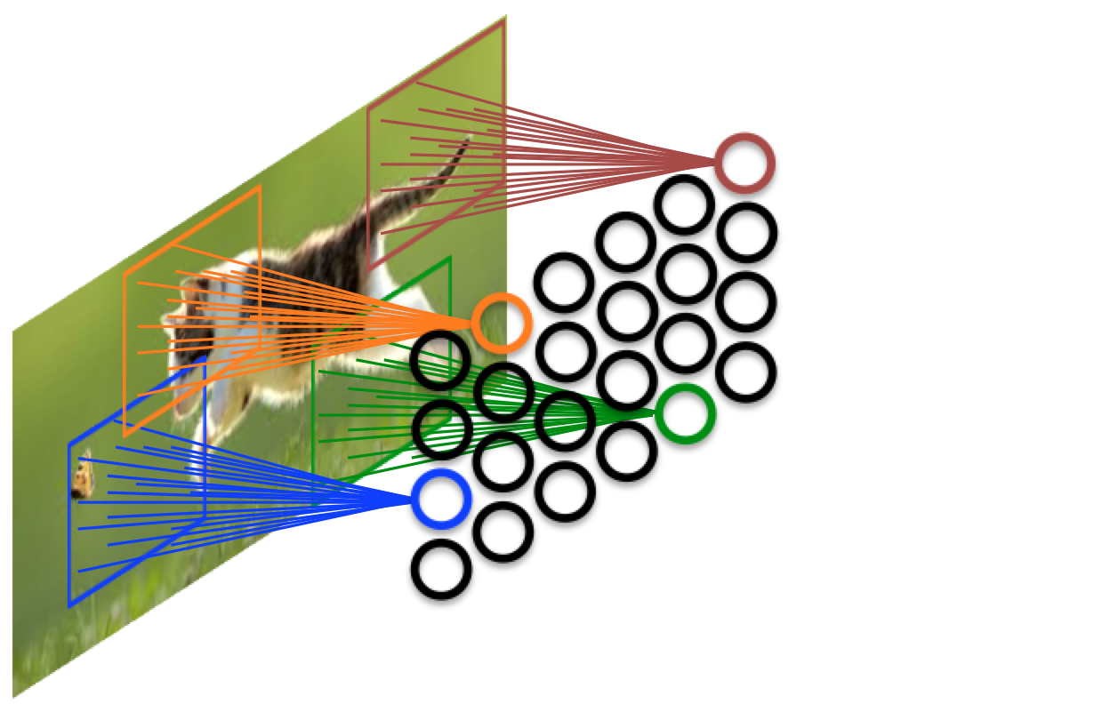
Locally Connected Neurons
Stationarity in vision: The same feature may appear anywhere!
Each neuron detects a different pattern.
Kernel of a neuron: Spatially limited connections.
Example:
If kernel = 10x10, 100 weights/pattern.
Each neuron only detects a pattern at a certain location.

Slide 16
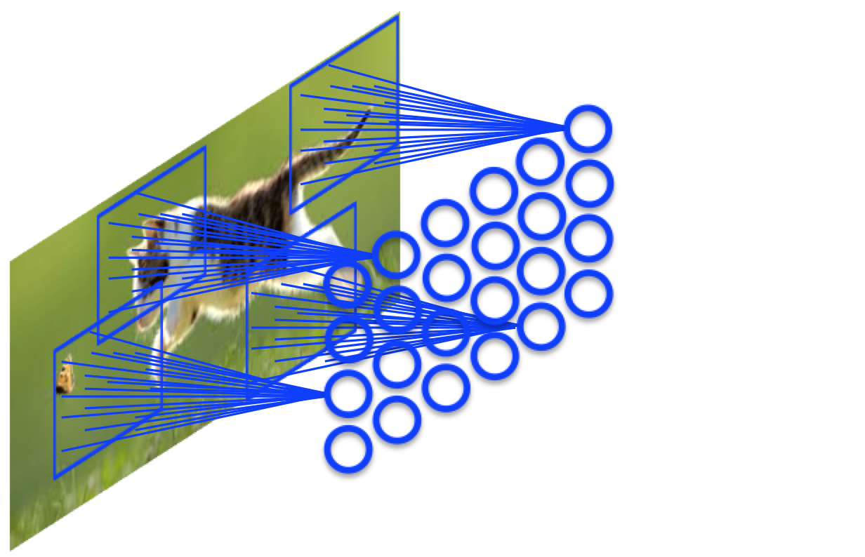
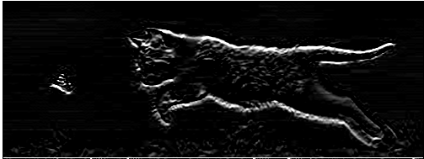

Weight Sharing – Feature Maps
Single neuron:
Feature Map:
Feature Map (FM), aka Channel:
Multiple neurons that share the same kernel (weights).
All neurons look for the same pattern/feature.
Spatially arranged to look at different locations.
Activations of a FM’s neurons computed with convolution with FM’s kernel!
A FM can be perceived as an image, the result of convolution.
Notes:
a( \mathbf{x}) = f \left( \sum_i w_i x_i + b \right)
\mathbf{a}(\mathbf{x}) = f (\mathbf{x} \ast \mathbf{w} + b)

Slide 17
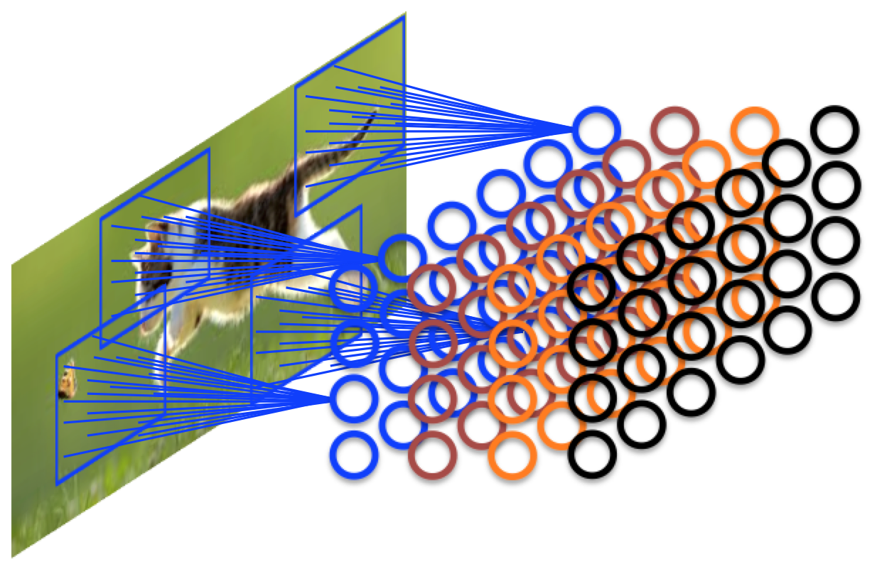
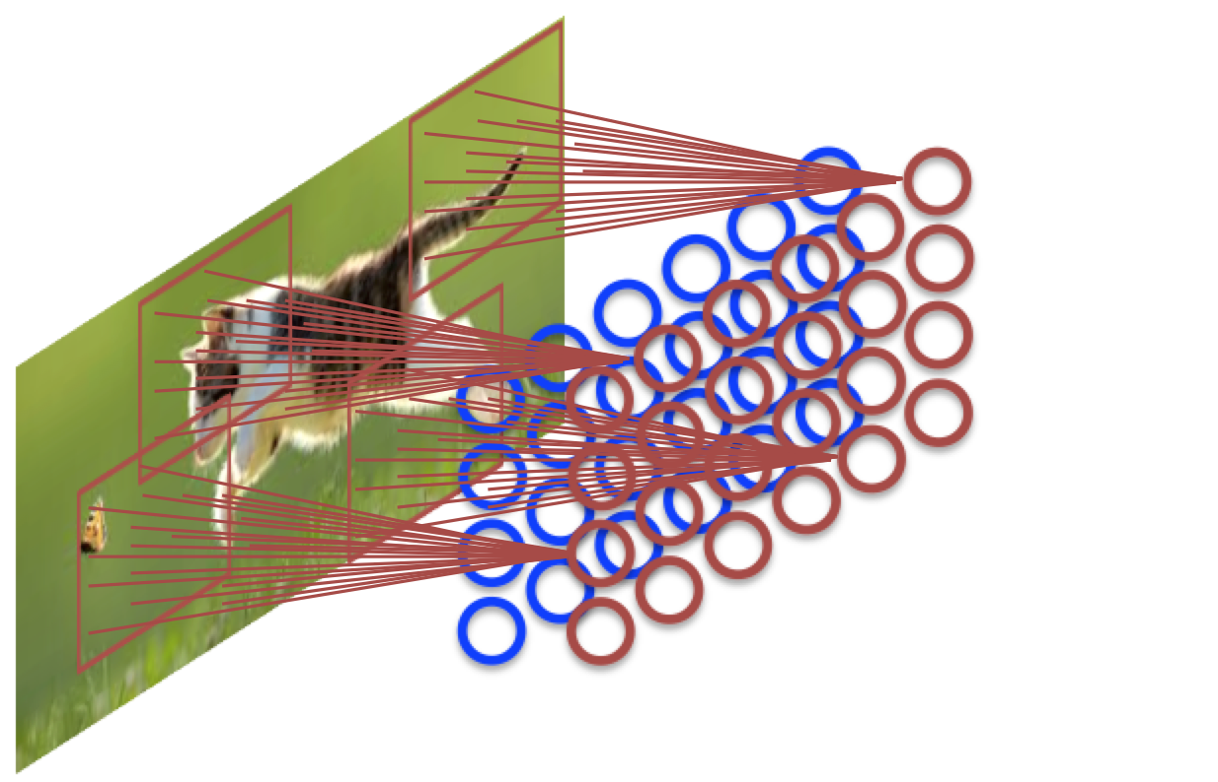
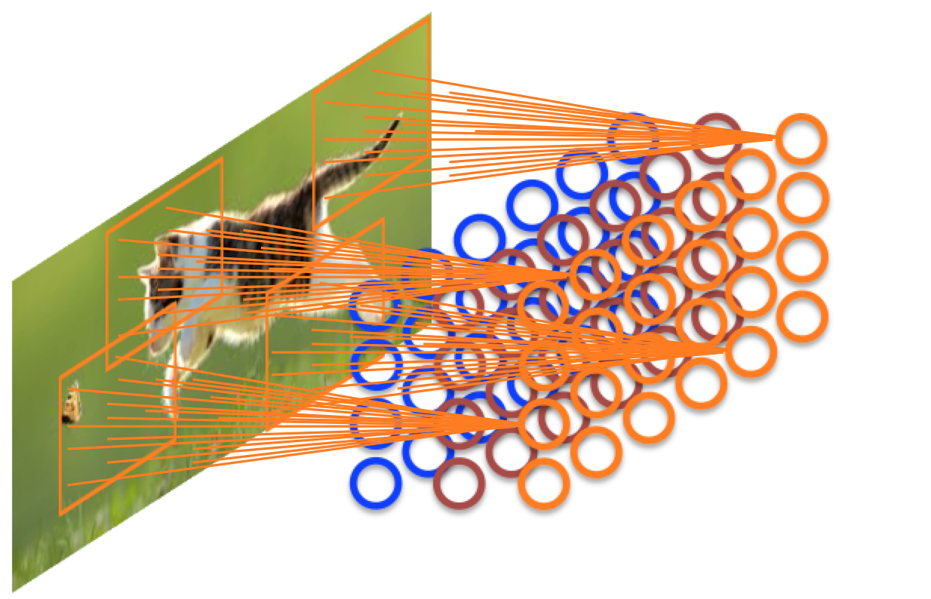
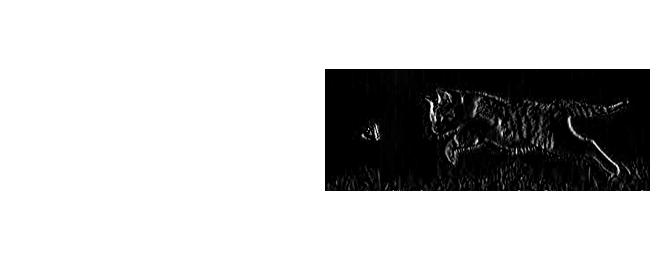
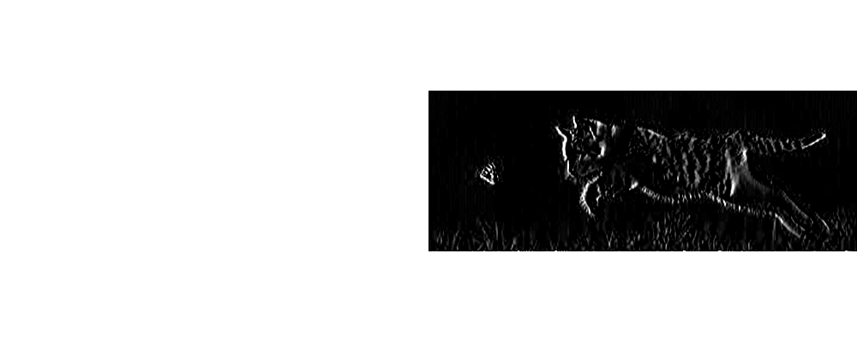
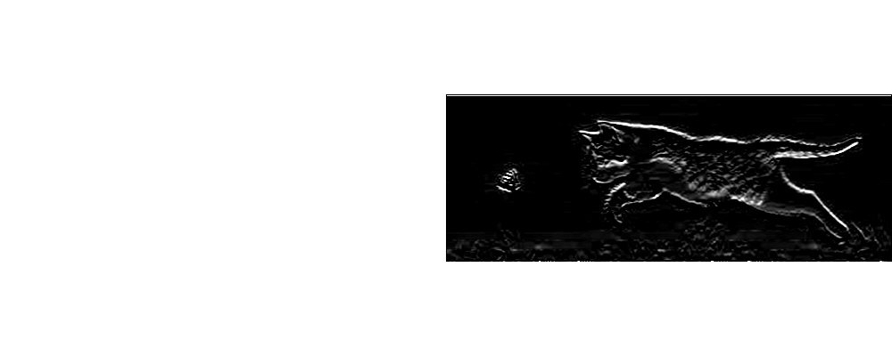
Convolutional Layer
Convolutional Layer:
Multiple Feature Maps – Detect multiple features per layer.
A layer can be perceived as a multi-channel image (similar to RGB channels).

Slide 18
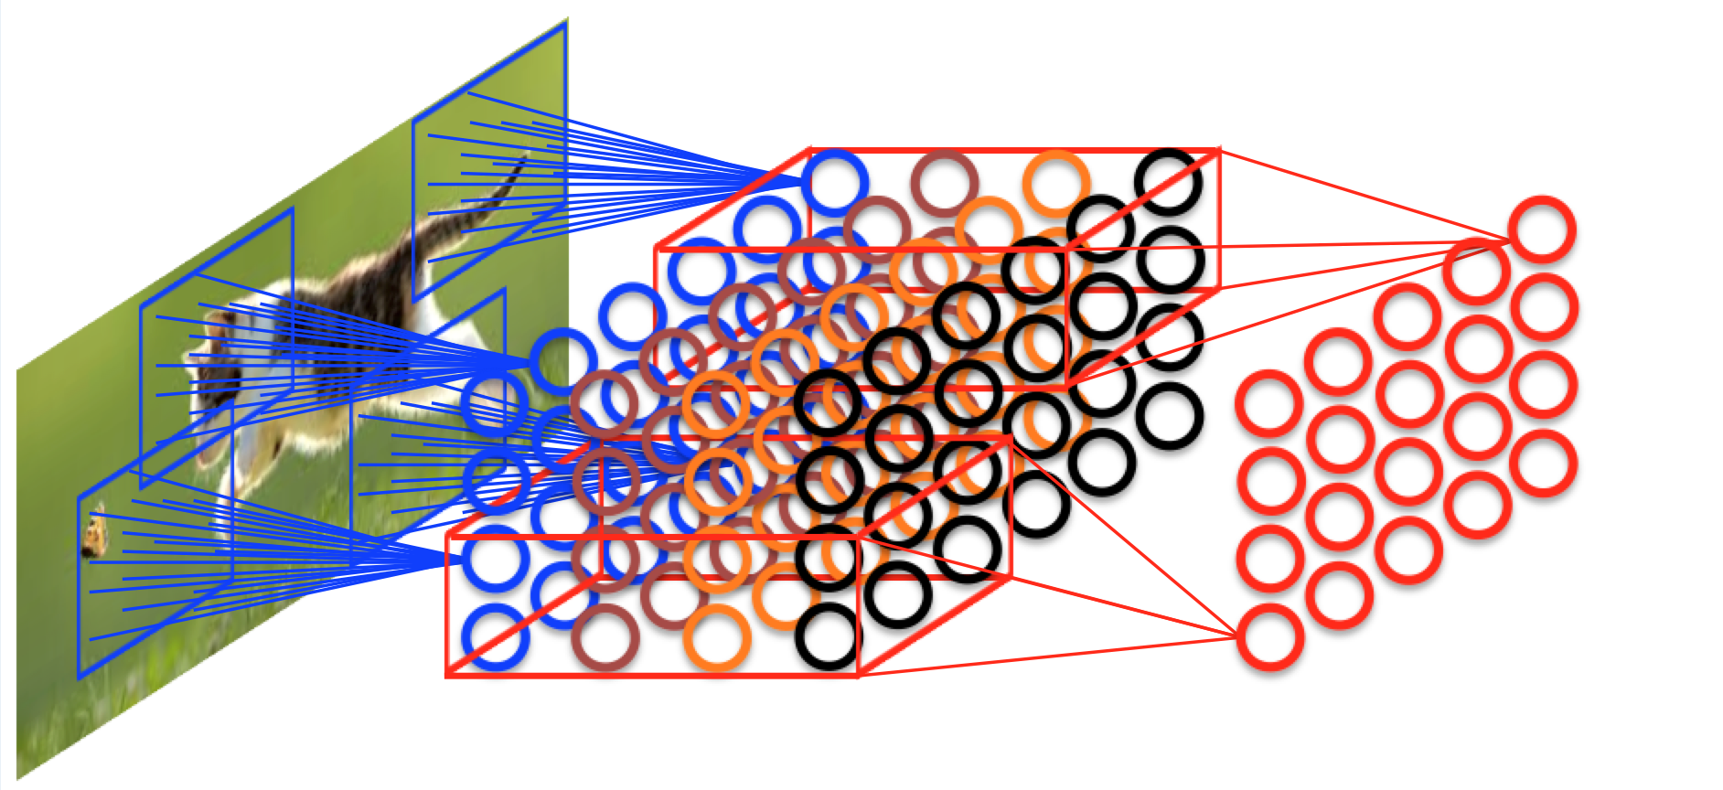
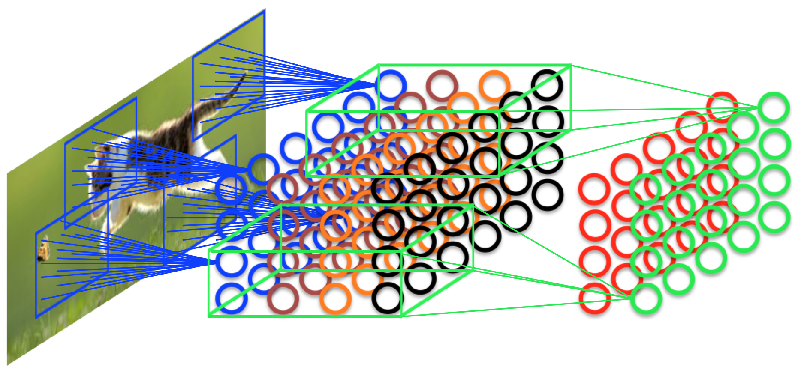
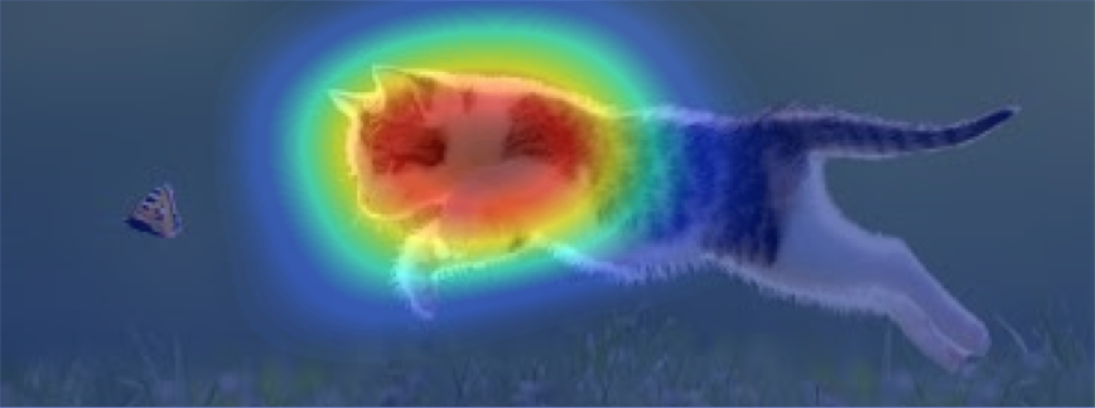
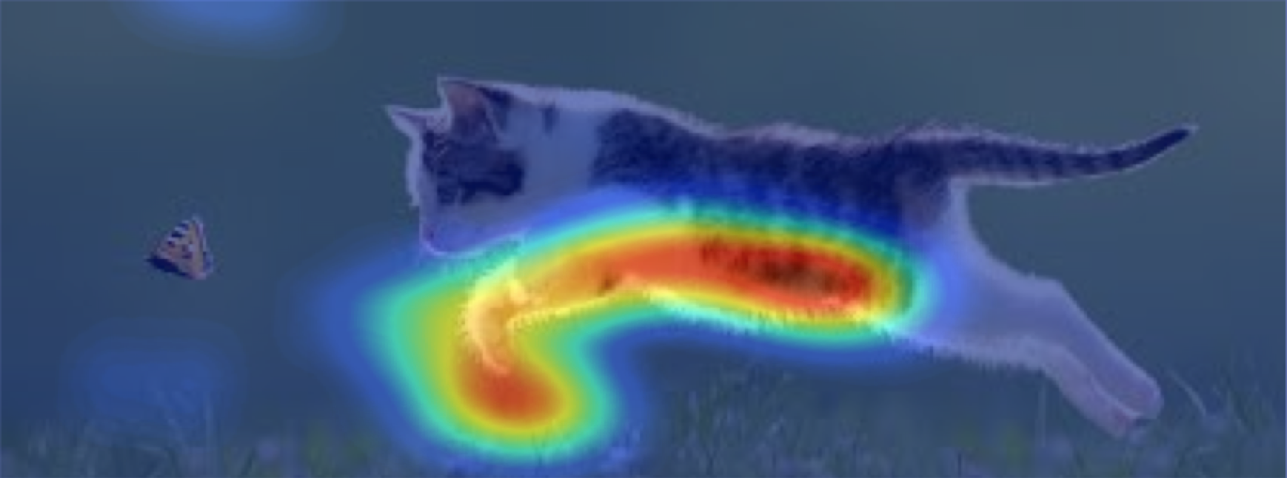
Multiple Convolutional Layers
Convolutional Layer:
Multiple Feature Maps – Detect multiple features per layer.
A layer can be perceived as a multi-channel image (similar to RGB channels).
Deeper layers process FMs (channels) of previous layer.
Combine previous features to extract more complex representations.

Slide 19
Convolution Arithmetic

Slide 20
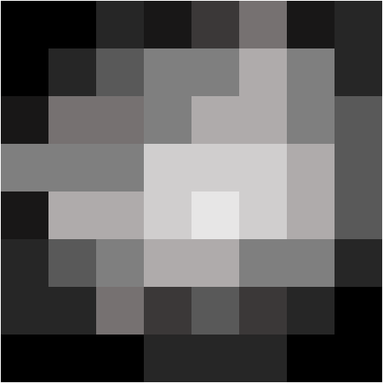
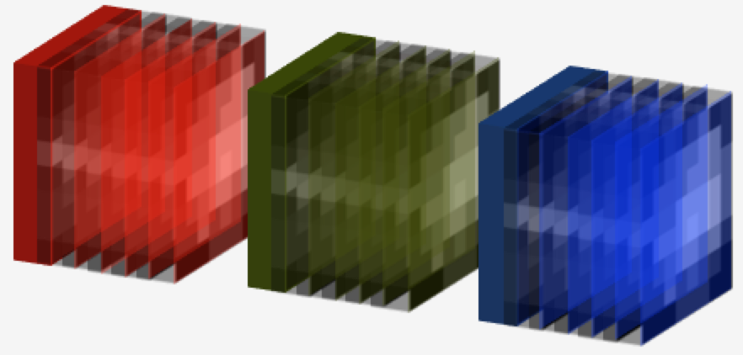
Input: Formats
y
y
y
x
x
x
c
z
2D image, 1 channel
2D tensor (x,y)
Eg: black & white image
2D image, 3 channels
3D tensor (x,y,c) Eg: RGB image
3D image, 1 channel
3D tensor (x,y,z)
Eg: CT volume
c=1
y
c=2
c=3
C
3D image, 3 channels
4D tensor (x,y,z,c)
Eg: MRI volumes of 3 modalities
x
z
z
z

Slide 21
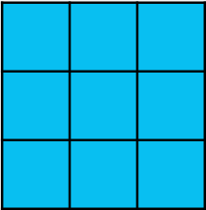
Convolution
Input (x)
Kernel (w)
o(x) = w * x
Feature Map:
Example #1
*
If 2D kernel w of dimensions K^{(x)} x K^{(y)}:
Input (x)
O(x) = w * x
0 | 4 | 5 | 5 | 4 | 1
4 | 6 | 6 | 6 | 5 | 3
5 | 6 | 7 | 6 | 5 | 3
4 | 5 | 5 | 4 | 4 | 1
1 | 2 | 3 | 2 | 1 | 0
0 | 1 | 1 | 1 | 0 | 0
Kernel (w)
 | -11 | -7 | -5 | -8
 | 3 | 5 | 6 | 6
 | 16 | 5 | 16 | 15
 | 16 | 15 | 14 | 12
1 | 2 | 1
0 | 0 | 0
-1 | -2 | -1
Example #2
*
Output dimensions:
D^{out} = D^{in} – (K-1)
Notes:
\mathbf{a}(\mathbf{x}) = f (\mathbf{x} \ast \mathbf{w} + b) = f(\mathbf{o}(\mathbf{x}) + b)
\mathbf{o}(\mathbf{x}) = \mathbf{x} \ast \mathbf{w}
\mathbf{o}[i,j] = \sum_{u=1}^{K^{(x)}} \sum_{v=1}^{K^{(y)}} \mathbf{x} [i + u, j + v ] \cdot \mathbf{w} [u, v ]

Slide 22
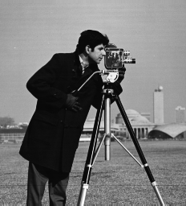
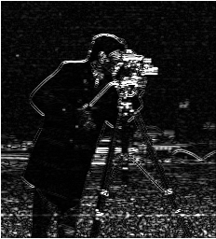
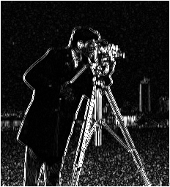
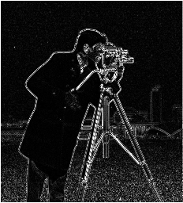
Convolution - Examples
Input (x)
Kernel (w)
Feature Map (o)
-1 | -1 | -1
1 | 1 | 1
-1 | -1 | -1
*
Horizontal Edges
Example #1
-1 | 1 | -1
-1 | 1 | -1
-1 | 1 | -1
Example #2
*
Vertical Edges
0 | 1 | 0
1 | -4 | 1
0 | 1 | 0
Example #3
*
All Edges
Notes:
Online convolution tool: http://matlabtricks.com/post-5/3x3-convolution-kernels-with-online-demo

Slide 23












2D image
2D input
2D FM
FM #2
y
2D kernel
Each feature map:
*
x
*
Kernel #2
Using 2D input channels for different z-slices (2.5D), is suboptimal, non-hierarchical spatial processing
2D input x C
2D FM
FM #2
y
2D kern. x C
*
x
c
*
Kernel #2
Notes:
\mathbf{o}[i,j] = \sum_{u=1}^{K^{(x)}} \sum_{v=1}^{K^{(y)}} \mathbf{x} [i + u, j + v ] \cdot \mathbf{w} [u, v ]
\mathbf{o}[i,j] = \sum_{c=1}^{C} \sum_{u=1}^{K^{(x)}} \sum_{v=1}^{K^{(y)}} \mathbf{x} [i + u, j + v, c ] \cdot \mathbf{w} [u, v, c ]

Slide 24






3D image
3D input
3D kern.
3D FM:
y
*
x
*
z
In fully 3D CNNs, all FMs are 3D:
The cause of the memory problems
3D volume x C channels
2D kern. x C
3D FM
y
C
*
x
z
z
z
Notes:
\mathbf{o}[i,j,k] = \sum_{u=1}^{K^{(x)}} \sum_{v=1}^{K^{(y)}} \sum_{w=1}^{K^{(z)}} \mathbf{x} [i + u, j + v, k + w ] \cdot \mathbf{w} [u, v, w ]
\mathbf{o}[i,j,k] = \sum_{c=1}^{C} \sum_{u=1}^{K^{(x)}} \sum_{v=1}^{K^{(y)}} \sum_{w=1}^{K^{(z)}} \mathbf{x} [i + u, j + v, k + w, c ] \cdot \mathbf{w} [u, v, w, c ]

Slide 25
Anisotropic 3D volume
z
Low res. axis
High res. axes
y
x
7mm spacing
For 3D processing:
Resample volumes to isotropic resol.
OR
Adjust dimensions of kernels. Square/cubic kernels not required!
15
1mm spacing
15 voxels
15
3 vox.
1mm spacing
Notes:
o[i,j] = \sum_{k=1}^{K^{(x)}} \sum_{l=1}^{K^{(y)}} x [i + k, j+l ] \cdot w [k, l ]

Slide 26
Building a basic segmenter

Slide 27




Basic Classifier
Image patch
Convolutional Layers (all kernels dim. K = 5³)
Fully connected
Layer
Classification Neurons
13³
9³
5³
1³
17³
Size of a feature map (FM) at layer (l):
the stride of the kernel at layer l. Here, s=1.
Size of receptive field increases with every layer (l):
the stride of the receptive field at layer l. Here, s’=1
Receptive field of a neuron:
Area in the input that influences its activation.
Input
FM at layer#1
FM at layer#2
FM at layer#3
FM at layer#4
Notes:
d_{l} = \lfloor (d_{l-1} – k_l) / s_{l} + 1 \rfloor
r_{l} = r_{l-1} + ( k_l – 1 ) \cdot s^{\prime}_{l}

Slide 28



Basic Segmenter: via patch classification
Image patch
Convolutional Layers (all kernels dim. = 5³)
Fully connected
Layer
Prediction for central voxel
Training Labels
Classification Neurons
13³
9³
5³
1³
17³

Slide 29


Basic Segmenter: Computational redundancy
Image patch
Convolutional Layers (all kernels dim. = 5³)
Fully connected
Layer
Prediction for central voxel
Classification Neurons
13³
9³
5³
1³
17³
Overlapping patches:
Redundant computations (re-convolve)
Inefficient memory usage (context reloaded, eg in same batch)

Slide 30






Changing fully connected layers to convolutional layers
3 x 2D Feature maps of previous conv. layer
Fully connected neurons of next fully connected layer
w'₃₁
w'₃₂
a₃₁ | a₃₂
a₃₃ | a₃₄
w₃₁
w₃₂
w'₃₃
w'₃₄
neuron #2
FM #3
w₃₃
w₃₄
w'₂₁
w'₂₂
w'₁₁
w'₁₂
w₂₁
w'₂₃
w'₂₄
w'₁₃
w'₁₄
a₂₁ | a₂₂
a₂₃ | a₂₄
w₂₂
FM #2
w₂₃
w₂₄
neuron #1
w₁₁
w₁₂
a₁₁ | a₁₂
a₁₃ | a₁₄
w₁₃
w₁₄
FM #1
Next layer’s FMs.
(FM dimensions=1x1)
a₃₁ | a₃₂
a₃₃ | a₃₄
FM #2
*
a₂₁ | a₂₂
a₂₃ | a₂₄
FM #1
Conv. kernel with C=3
a₁₁ | a₁₂
a₁₃ | a₁₄

Slide 31



Fully Convolutional segmenter
Convolutional Layers
Fully connected
Layer
Prediction for central voxel
Classification Neurons
13³
9³
5³
1³
17³
Fully convolutional
Conv. with 1³kernels
Deterministically exact same behavior
Classification Feature Maps
9³
5³
1³
1³
17³
13³
1³
Can be efficiently applied on inputs of arbitrary dimensions!
Flexible & efficient!
Image segment/ sub-volume
Segmentation of multiple (9³) voxels
17³

Slide 32

FM size expands with input
Input
FM at layer#1
FM at layer#2
FM at layer#3
FM at layer#4
Size of receptive field remains the same!
Each prediction is only influenced by its own receptive field. NOT the whole input!
Notes:
d_{l} = \lfloor (d_{l-1} – k_l) / s_{l} + 1 \rfloor
r_{l} = r_{l-1} + ( k_l – 1 ) \cdot s^{\prime}_{l}

Slide 33
Fully convolutional segmenter
Fully convolutional implementation:
Dimensions of all FMs scale with input dim.
Including Classification FMs!
Efficiency: Densely-predict multiple voxels in one pass, avoiding computational redundancy on overlapping context!
Fully convolutional
Conv. with 1³kernels
Classification Feature Maps
9³
5³
1³
1³
17³
13³
1³
Can be efficiently applied on inputs of arbitrary dimensions!
Flexible & efficient!
Image segment/ sub-volume
Segmentation of multiple (9³) voxels
17³
Notes:
Point 3 is very important. Thanks to it, FCNs are very efficient in the way the apply the computations, avoiding overlaps and make dense predictions quickly. Without it, an MRI takes hours to process and everyone was reporting 3D CNNs are slow and impossible to train and apply... We showed in our work 2 years back that they can be scaled up and applied efficiently using this trick.

Slide 34




Tiling an image for segmentation
Out of bounds for valid conv. (half receptive field)
Redundant repeated convolutions still happen here.
Bigger input tiles (segments):
Require more memory. Because all FMs expand.
Less computational redundancy because of less overlap in between.
Tiles at testing time do not need to be the same size as at training.

Slide 35

Padding: Keep FM dimensions “same”
Dim. D^{in} x D^{in}
Dim. K x K
Output dimensions:
D^{out} = D^{in} – (K-1)
0 | 4 | 5 | 5 | 4 | 1
4 | 6 | 6 | 6 | 5 | 3
5 | 6 | 7 | 6 | 5 | 3
4 | 5 | 5 | 4 | 4 | 1
1 | 2 | 3 | 2 | 1 | 0
0 | 1 | 1 | 1 | 0 | 0
1 | 2 | 1
0 | 0 | 0
-1 | -2 | -1
-11 | -7 | -5 | -8
3 | 5 | 6 | 6
16 | 5 | 16 | 15
16 | 15 | 14 | 12
*
+ Convenient
- Synthetic content
Use other padding?
eg Mirror content.
“Valid” Convolution
Influenced by padding.
0 | 0 | 0 | 0 | 0 | 0 | 0 | 0
0 | 0 | 4 | 5 | 5 | 4 | 1 | 0
0 | 4 | 6 | 6 | 6 | 5 | 3 | 0
0 | 5 | 6 | 7 | 6 | 5 | 3 | 0
0 | 4 | 5 | 5 | 4 | 4 | 1 | 0
0 | 1 | 2 | 3 | 2 | 1 | 0 | 0
0 | 0 | 1 | 1 | 1 | 0 | 0 | 0
0 | 0 | 0 | 0 | 0 | 0 | 0 | 0
? | ? | ? | ? | ? | ?
? | -11 | -7 | -5 | -8 | ?
? | 3 | 5 | 6 | 6 | ?
? | 16 | 5 | 16 | 15 | ?
? | 16 | 15 | 14 | 12 | ?
? | ? | ? | ? | ? | ?
1 | 2 | 1
0 | 0 | 0
-1 | -2 | -1
“Same” Convolution
*

Slide 36




Boundary effect
Layer #1
Layer #2
Padded input
Kernel
Output
Padded input
Kernel
Output
0 | 0 | 0 | 0 | 0 | 0 | 0 | 0
0 | 0 | 4 | 5 | 5 | 4 | 1 | 0
0 | 4 | 6 | 6 | 6 | 5 | 3 | 0
0 | 5 | 6 | 7 | 6 | 5 | 3 | 0
0 | 4 | 5 | 5 | 4 | 4 | 1 | 0
0 | 1 | 2 | 3 | 2 | 1 | 0 | 0
0 | 0 | 1 | 1 | 1 | 0 | 0 | 0
0 | 0 | 0 | 0 | 0 | 0 | 0 | 0
0 | 0 | 0 | 0 | 0 | 0 | 0 | 0
0 | ? | ? | ? | ? | ? | ? | 0
0 | ? | -11 | -7 | -5 | -8 | ? | 0
0 | ? | 3 | 5 | 6 | 6 | ? | 0
0 | ? | 16 | 5 | 16 | 15 | ? | 0
0 | ? | 16 | 15 | 14 | 12 | ? | 0
0 | ? | ? | ? | ? | ? | ? | 0
0 | 0 | 0 | 0 | 0 | 0 | 0 | 0
? | ? | ? | ? | ? | ?
? | -11 | -7 | -5 | -8 | ?
? | 3 | 5 | 6 | 6 | ?
? | 16 | 5 | 16 | 15 | ?
? | 16 | 15 | 14 | 12 | ?
? | ? | ? | ? | ? | ?
? | ? | ? | ? | ? | ?
? | ? | ? | ? | ? | ?
? | ? | 5 | 6 | ? | ?
? | ? | 5 | 16 | ? | ?
? | ? | ? | ? | ? | ?
? | ? | ? | ? | ? | ?
*
1 | 2 | 1
0 | 0 | 0
-1 | -2 | -1
*
1 | 2 | 1
0 | 0 | 0
-1 | -2 | -1
Influenced by padding.
Influenced by padding.
Patterns/artifacts that may show up due to padding (exaggerated for clarity): (segmentation or regression. Not classification)
If processing whole image at testing.
If tiling the image at testing.

Slide 37
Training a fully convolutional net
Training with single predictions on each sample:
x_{s}
Learn parameters
Size of input segments can be different for training and testing settings!
Train: Takes more memory (back+fwd pass), so use smaller inputs.
Test: Only fwd pass. Could infer whole brain volume in one pass.
(B) samples for a batch
Cross Entropy over all the samples of a batch (B).
x_{s} a training sample (patch), y_{s} the true label of its central voxel.
f_{c}(x) the CNN’s confidence for predicting class c.
[.] the indicator function.
(V) classified voxels
Segment
Training on dense predictions:
Over the (B) segments (s) in a batch.
Increase number of samples per batch.
Without linear increase in computation (eg if loading V separate patches).
Over the (V) classified voxels in a segment.
Notes:
\mathcal{L} = - \frac{1}{B} \sum_{ s=1 }^{B} \sum_{c} [c=y_s] log(f_c(x_s; \theta))
\mathcal{L} = - \frac{1}{B \cdot V} \sum_{ s=1 }^{B} \sum_{v=1}^{V} \sum_{c} [c=y_s^v] log(f_c(x_s^v; \theta))

Slide 38
Building a better network
How to process more context?
Add more layers?
Receptive field increases linearly with each layer (by k-1).
Required memory increases linearly (almost) with number of conv layers.
Process input at multiple scales.
Notes:
Example: for 2 times greater context, 2 times more layers, and thus parameters and memory!

Slide 39

Multi-scale processing with parallel pathways
Centered at same location, extract context at normal and at lower resolution.
Separate pathways process image at different resolutions (can be more than 2).
Low-res pathway processes greater physical context with the same number of kernels.
The down-sampling factor (here x3) controls amount of context.
Context de-coupled from memory/computational requirements.
Can adjust pathways separately. Commonly symmetrical.
Upsample the low-res features back to normal resolution.
Concatenate FMs from two pathways.
Kamnitsas et al, “Efficient multi-scale 3d CNN with fully connected CRF for accurate brain lesion segmentation”, MedIA, 2017.

Slide 40



Multi-scale processing with parallel pathways
Additional spatial information enhances network’s localization capabilities

Slide 41


Going deeper with smaller kernels
Deeper architectures can represent more complex functions.
Too many free parameters if we simply start adding more layers.
Use only layers with small kernels [Simonyan et al, 2014].
Number of weights in layer , with FMs, that uses kernels of dimensions k^3:
Total receptive field remains the same.
Less total parameters, especially for 3D [Kamnitsas 2017]!
They tend to work (much) better. Common in SotA builds nowadays.
Notes:
k^3 \times C^{(l-1)} \times C^{(l)}

Slide 42


DeepMedic
[1] Kamnitsas et al, “Multi-scale 3D convolutional neural networks for lesion segmentation in Brain MRI”, MICCAI–ISLES, 2015.
[2] Kamnitsas et al, “Efficient multi-scale 3D CNN with fully connected CRF for accurate brain lesion segmentation”, MedIA, 2017.
[3] Code at: https://github.com/Kamnitsask/deepmedic

Slide 43


DeepMedic: Stroke Lesions
MICCAI 2015
ISLES Challenge [Maier MedIA 2017]:
Ischemic Stroke Lesion Segmentation
Trained on 28 subjects
Tested on 36 subjects
Won 1st position in challenge.

Slide 44

DeepMedic: Traumatic Brain Injuries
Multi-scale processing:
Capable of segmenting accurately both small and large lesions.
Kamnitsas et al, “Efficient multi-scale 3d CNN with fully connected CRF for accurate brain lesion segmentation”, MedIA, 2017.

Slide 45

DeepMedic: Traumatic Brain Injuries
Kamnitsas et al, “Efficient multi-scale 3d CNN with fully connected CRF for accurate brain lesion segmentation”, MedIA, 2017.

Slide 46





DeepMedic: Various :-)
Placenta in US
[1] Kamnitsas et al, “Multi-scale 3D convolutional neural networks for lesion segmentation in Brain MRI”, MICCAI–ISLES, 2015.
[2] Kamnitsas et al, “Efficient multi-scale 3d CNN with fully connected CRF for accurate brain lesion segmentation”, MedIA, 2017.
[3] Alansary et al “Fast fully automatic of the human placenta from motion corrupted data”, MICCAI 2016.
[4] Giannakidis et al, “Fast fully automatic segmentation of the severely abnormal human right ventricle…”, SITIS 2016.
[5] Gordon et al, “Automatic 3D ultrasound segmentation of the first trimester placenta using deep learning”, ISBI 2017.

Slide 47


DeepMedic: Deep Gray Matter
Dolz et al, “3D fully convolutional networks for subcortical segmentation in MRI : A large-scale study”, NeuroImage 2017

Slide 48

Interpreting Feature Maps
Kamnitsas et al, “Efficient multi-scale 3d CNN with fully connected CRF for accurate brain lesion segmentation”, MedIA, 2017.

Slide 49

Interpreting Feature Maps
Kamnitsas et al, “Efficient multi-scale 3d CNN with fully connected CRF for accurate brain lesion segmentation”, MedIA, 2017.

Slide 50
Part 2
…we have loads more to learn..!

Slide 51


Pooling
Pooling operator:
Kernel of dimension k
Stride s of convolution
Kernel function: max (mostly), mean…
No learnt parameters.
Applied individually on each FM.
Motivation:
Reduce size (memory) of deeper layers.
Invariance to small translations.
(A blob a pixel to the right is still a blob.)
+ Fine/good for classification.
- Segmentation? Less obvious.
FM in
1 | -0 | 1 | 1
-2 | -1 | 2 | 0
0 | 3 | -3 | 0
0 | 1 | 1 | 3
k=2, s=2
FM out
10 FMs
y
10 FMs
Non-overlapping
*
1 | 2
3 | 3
224
112
224
112
x
FM in
k=3, s=2
(Source: Stanford’s CS231n github)
Overlapping
*
max

Slide 52
Strided Convolution
Pooling operator:
Kernel of dimension k
Stride s of convolution.
Kernel function: max (mostly), mean…
How much to down-sample
How to down-sample
Just learn it!
FM in
y
1 | -0 | 1 | 1
-2 | -1 | 2 | 0
0 | 3 | -3 | 0
0 | 1 | 1 | 3
k=2, s=2
FM out
w1 | w2
w3 | w4
1 | 2
3 | 3
*
max
x
Strided convolution:
Like normal convolutional (as before), but with a stride s != 1.
Down-samples input by a factor of s.
Learn the kernel weights, so it “learns how to down-sample”.
Often works better, commonly now replacing max-pooling.
Springenberg et al, “Striving for simplicity: the all convolutional net”, ICLR workshop, 2015.

Slide 53













Strided conv./ pool: Downsampling & Receptive field
k=3
Activation
No activation for pixel
Input
L1: s=1

Slide 54




Strided conv./ pool: Downsampling & Receptive field
k=3
Activation
No activation for pixel
Input
L1: s=1, s’=1, r=3
L2: s=1, s’=1, r=5
L3: s=1, s’=1, r=7
L4: s=1, s’=1, r=9
Stride of receptive field at layer (l):
Size of receptive field at layer (l):
Size of a feature map at layer (l):
the stride of the kernel at layer l.
Notes:
s_l^{\prime} = s_{l-1}^{\prime} \cdot s_{l} = \prod_{i=1}^{l} s_i
d_{l} = \lfloor (d_{l-1} – k_l) / s_{l} + 1 \rfloor
r_{l} = r_{l-1} + ( k_l – 1 ) \cdot s^{\prime}_{l-1}

Slide 55



Strided conv./ pool: Downsampling & Receptive field
k=3
Activation
No activation for pixel
Input
L1: s=1, s’=1, r=3
L2: s=1, s’=1, r=5
L3: s=1, s’=1, r=7
L4: s=1, s’=1, r=9
Stride of receptive field at layer (l):
Size of receptive field at layer (l):
Size of a feature map at layer (l):
the stride of the kernel at layer l.
Input
L1: s=1, s’=1, r=3
L2: s=2, s’=2, r=5

Slide 56
Strided conv./ pool: Downsampling & Receptive field
k=3
Activation
No activation for pixel
Input
L1: s=1, s’=1, r=3
L2: s=1, s’=1, r=5
L3: s=1, s’=1, r=7
L4: s=1, s’=1, r=9
Stride of receptive field at layer (l):
Size of receptive field at layer (l):
Size of a feature map at layer (l):
the stride of the kernel at layer l.
Input
L1: s=1, s’=1, r=3
L2: s=2, s’=2, r=5
L3: s=1, s’=2, r=9

Slide 57
Strided conv./ pool: Downsampling & Receptive field
k=3
Activation
No activation for pixel
Input
L1: s=1, s’=1, r=3
L2: s=1, s’=1, r=5
L3: s=1, s’=1, r=7
L4: s=1, s’=1, r=9
Stride of receptive field at layer (l):
Size of receptive field at layer (l):
Size of a feature map at layer (l):
the stride of the kernel at layer l.
Input
L1: s=1, s’=1, r=3
L2: s=2, s’=2, r=5
L3: s=1, s’=2, r=9
L4: s=2, s’=4, r=13

Slide 58
Strided conv./ pool: Downsampling & Receptive field
k=3
Activation
No activation for pixel
Input
L1: s=1, s’=1, r=3
L2: s=1, s’=1, r=5
L3: s=1, s’=1, r=7
L4: s=1, s’=1, r=9
Stride of receptive field at layer (l):
Size of receptive field at layer (l):
Size of a feature map at layer (l):
the stride of the kernel at layer l.
Input
L1: s=1, s’=1, r=3
L2: s=2, s’=2, r=5
L3: s=1, s’=2, r=9
L4: s=2, s’=4, r=13

Slide 59

Upsampling
Low Res. FM in
0 | 0 | 0 | 0 | 0 | 0 | 0 | 0
0 | 5 | 0 | 3 | 0 | 1 | 0 | 0
0 | 0 | 0 | 0 | 0 | 0 | 0 | 0
0 | 0 | 0 | 2 | 0 | 4 | 0 | 0
0 | 0 | 0 | 0 | 0 | 0 | 0 | 0
0 | 4 | 0 | 3 | 0 | 5 | 0 | 0
0 | 0 | 0 | 0 | 0 | 0 | 0 | 0
0 | 0 | 0 | 0 | 0 | 0 | 0 | 0
Upsampled FM out
5 | 4 | 3 | 2 | 1 | 0.5
2.5 | 2.5 | 3.5 | 2.5 | 2.5 | 1.3
0 | 1 | 2 | 3 | 4 | 2
2 | 2.3 | 2.5 | 3.5 | 4.5 | 2.3
4 | 3.5 | 3 | 4 | 5 | 2.5
2 | 1.8 | 1.5 | 2 | 2.5 | 1.3
5 | 3 | 1
0 | 2 | 4
4 | 3 | 5
0.25 | 0.5 | 0.25
0.5 | 1 | 0.5
0.25 | 0.5 | 0.25
*

Slide 60


Deconvolution aka transposed convolution
Deconvolution / transposed conv: Learn to upsample
Kernel dimension k: how much context influences upsampling
Stride s of convolution: The upsampling factor
Padding p: careful, to get exact output shape wanted
Low Res. FM in
0 | 0 | 0 | 0 | 0 | 0 | 0 | 0
0 | 5 | 0 | 3 | 0 | 1 | 0 | 0
0 | 0 | 0 | 0 | 0 | 0 | 0 | 0
0 | 0 | 0 | 2 | 0 | 4 | 0 | 0
0 | 0 | 0 | 0 | 0 | 0 | 0 | 0
0 | 4 | 0 | 3 | 0 | 5 | 0 | 0
0 | 0 | 0 | 0 | 0 | 0 | 0 | 0
0 | 0 | 0 | 0 | 0 | 0 | 0 | 0
Upsampled FM out
k=3, s=2, p=2
5 | 3 | 1
0 | 2 | 4
4 | 3 | 5
w1 | w2 | w3
w4 | w5 | w6
w7 | w8 | w9
Better, data-driven upsampling!
*
Way #2 to perceive it:
Deconv(k,s,p) reverses the strided conv(k,s,p) which created the downsampled FM.
Strided conv(k,s,p)
deconv(k,s,p)
From: theano docs
Notes:
The simplest way to think about a transposed convolution is by computing the output shape of the direct convolution for a given input shape first, and then inverting the input and output shapes for the transposed convolution.
From theano docs: http://deeplearning.net/software/theano/tutorial/conv_arithmetic.html

Slide 61
Deconvolution #2 via Nearest Neighbours
Deconvolution via Zero-fill + Conv (common/backprop implementation):
Low Res. FM in
0 | 0 | 0 | 0 | 0 | 0 | 0 | 0
0 | 5 | 0 | 3 | 0 | 1 | 0 | 0
0 | 0 | 0 | 0 | 0 | 0 | 0 | 0
0 | 0 | 0 | 2 | 0 | 4 | 0 | 0
0 | 0 | 0 | 0 | 0 | 0 | 0 | 0
0 | 4 | 0 | 3 | 0 | 5 | 0 | 0
0 | 0 | 0 | 0 | 0 | 0 | 0 | 0
0 | 0 | 0 | 0 | 0 | 0 | 0 | 0
Upsampled FM out
k=3, s=2, p=2
5 | 3 | 1
0 | 2 | 4
4 | 3 | 5
w1 | w2 | w3
w4 | w5 | w6
w7 | w8 | w9
Better, data-driven upsampling!
*
Deconvolution via Nearest-Neighbors + Conv:
Low Res. FM in
0 | 0 | 0 | 0 | 0 | 0 | 0 | 0
0 | 5 | 5 | 3 | 3 | 1 | 1 | 0
0 | 5 | 5 | 3 | 3 | 1 | 1 | 0
0 | 0 | 0 | 2 | 2 | 4 | 4 | 0
0 | 0 | 0 | 2 | 2 | 4 | 4 | 0
0 | 4 | 4 | 3 | 3 | 5 | 5 | 0
0 | 4 | 4 | 3 | 3 | 5 | 5 | 0
0 | 0 | 0 | 0 | 0 | 0 | 0 | 0
k=3, s=2, p=2
5 | 3 | 1
0 | 2 | 4
4 | 3 | 5
w1 | w2 | w3
w4 | w5 | w6
w7 | w8 | w9
Smoother results!?!
*

Slide 62

Checkerboard artifacts
Deconv. via Zero-fill + Conv. :
Deconv. via NN + Conv. :
From: http://distill.pub/2016/deconv-checkerboard/

Slide 63





Encoder - Decoder networks for segmentation
skip connection
conv.
conv.
Downsample (strided pool/conv.)
Upsample (deconv, NN/bilin+conv…)
conv.
conv.
Encoder
Decoder
Noh et al, “Learning deconvolution network for semantic segmentation”, ICCV 2015
Long et al, “Fully convolutional networks for semantic segmentation”, CVPR 2015
Notes:
Now that we know deconvolution, we can go on and build some other SotA architectures.

Slide 64



FCN: Fully convolutional network
Long et al, Fully convolutional networks for semantic segmentation, CVPR 2015 (1800+ citations)
Deconvolution to upsample segmentation.
Skip connections to combine multi-scale info for better accuracy.
Popularized fully conv net (previously [LeCun ‘98, Farabet ’13])
High resolution
+
64
64
128
128
2x lower res.
+
256
256
4x lower res.
+
Convolution
8x lower res.
512
512
Max-pool
+
Deconv.
16x lower res.
Skip connection
1024
Segmentation maps
+
Add element-wise

Slide 65
FCN: Fully convolutional network
Long et al, Fully convolutional networks for semantic segmentation, CVPR 2015 (1800+ citations)
Deconvolution to upsample segmentation.
Skip connections to combine multi-scale info for better accuracy.
Popularized fully conv net (previously [LeCun ‘98, Farabet ’13])
High resolution
Concatenate
64
64
128
128
#Classes
2x lower res.
256
256
4x lower res.
Convolution
8x lower res.
512
512
Max-pool
Deconv.
16x lower res.
Skip connection
1024
Segmentation maps
+
Add element-wise

Slide 66

U-net
Ronneberger et al, “U-net: Convolutional networks for biomedical image segmentation”, MICCAI’15.
Extended FCN decoder with more filters.
Learns to up-sample and combine multi-scale features, not segmentations (unlike FCN).
Original version uses only “valid” convolution (no padding), processing only real content.
Often works better than FCN, with the trade-off of more expensive decoder.
Later extended to 3D in [Cicek 2016]
64
64
#Classes
64
64
128
128
256
256
128
128
512
512
256
256
Convolution
Up.+conv.
512
512
Max-pool
1024
Crop+concat.

Slide 67



What parts are important in SotA builds?
128x128x116
48x48x32
II.
44x44x28
I.
64
64
#Classes
32
64
64
128
II.
Convolution
128
256
128
128
Ups.+conv.
Classifiers benefit similarly from processing multi-scale features.
U-net’s full-resolution layers before first pooling are expensive for memory. Lots of high res content is not classified, only to be down-sampled.
DeepMedic avoids (II) and is memory efficient, but uses fixed down-sampling. Eg direct pooling. U-net’s first convs can learn what to down-sample.
DeepMedic can have many (11) layers processing high-resolution features, as they are small, offering precision. Often only few (4) layers of Unet can be at high resolution.
U-net early layers serve all scales, limiting capacity dedicated to high-res further. But avoids possible redundancy in DeepMedic’s decoupled pathways.
Max-pool
256
256
Crop+concat.
256
512
III.
I.
Notes:
3D Unet (3pools / 4scales) -> Input 132x132x116 --→ output 44x44x28

Slide 68
What parts are important in SotA builds?
128x128x116
48x48x32
44x44x28
64
64
#Classes
32
64
64
128
Convolution
128
256
128
128
Ups.+conv.
Max-pool
256
256
Crop+concat.
What to improve next?
256
512
Notes:
3, 5, -6/(2)-10, 14, -16(4)-, 24,32, -36(8)-, 52, 68, , -76(16)-, 92, 108,…………………
3D Unet (3ppols / 4scales) -> Input 132x132x116 --→ output 44x44x28

Slide 69


Fuse their strengths?! PyraMedic?!
128x128x116
48x48x32
44x44x28
64
64
#Classes
32
64
64
128
Convolution
128
256
128
128
Ups.+conv.
Max-pool
256
256
Crop+concat.
256
512

Slide 70
Practical Issues
Practical Issues

Slide 71


Class imbalance
Uniform sampling
Weighted sampling: 50/50

Slide 72

Class Imbalance in Fully Convolutional Nets
Size of input implicitly regulates class imbalance.
Kamnitsas et al, “Efficient multi-scale 3d CNN with fully connected CRF for accurate brain lesion segmentation”, MedIA, 2017.

Slide 73

Class Imbalance in Fully Convolutional Nets
Size of input can be exploited to achieve effective balance.
Partially adapts achieved class distribution wrt the data.
Major effect on segmentation accuracy.
Kamnitsas et al, “Efficient multi-scale 3d CNN with fully connected CRF for accurate brain lesion segmentation”, MedIA, 2017.

Slide 74
Approaches for countering imbalance
Sample classes with different weights.
Weighted cross-entropy
Optimise IoU, Dice, etc [Nowozin 2014]
Cascaded models: First model predicts a constrained ROI for the second.
Nowozin, “Optimal decision from probabilistic models: the intersection over union case.”, CVPR 2014.

Slide 75

Libraries
(Source: Francois Chollet’s tweet, August 2016)

Slide 76
We did not discuss
How to configure a network?
Layer normalizations (eg batchNorm,…)
SotA modules: Residuals, deep supervision, dilated conv…
Need for data & augmentation
Need for hardware
Other problems / tasks (unsupervised, generatives, transfer learning etc)
GANs, RNNs, VAEs, RL, etc…
Feel free to ask anything!

Slide 77


Thank you for your attention!
konstantinos.kamnitsas12@imperial.ac.uk
https://github.com/Kamnitsask
Acknowledgements:

